Slide 1
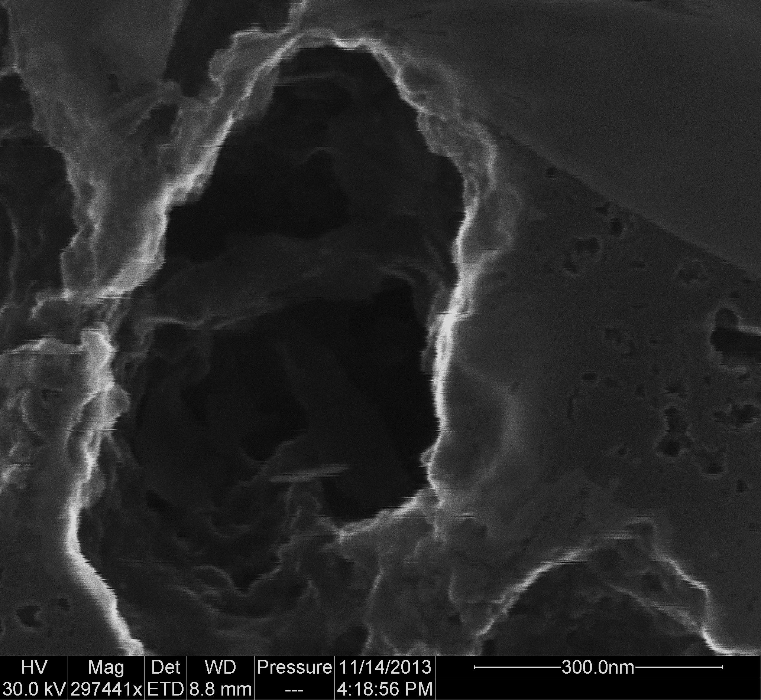

Porosity, Carbonate Content and TOC
Taury Smith
Smith Stratigraphic LLC

Slide 2
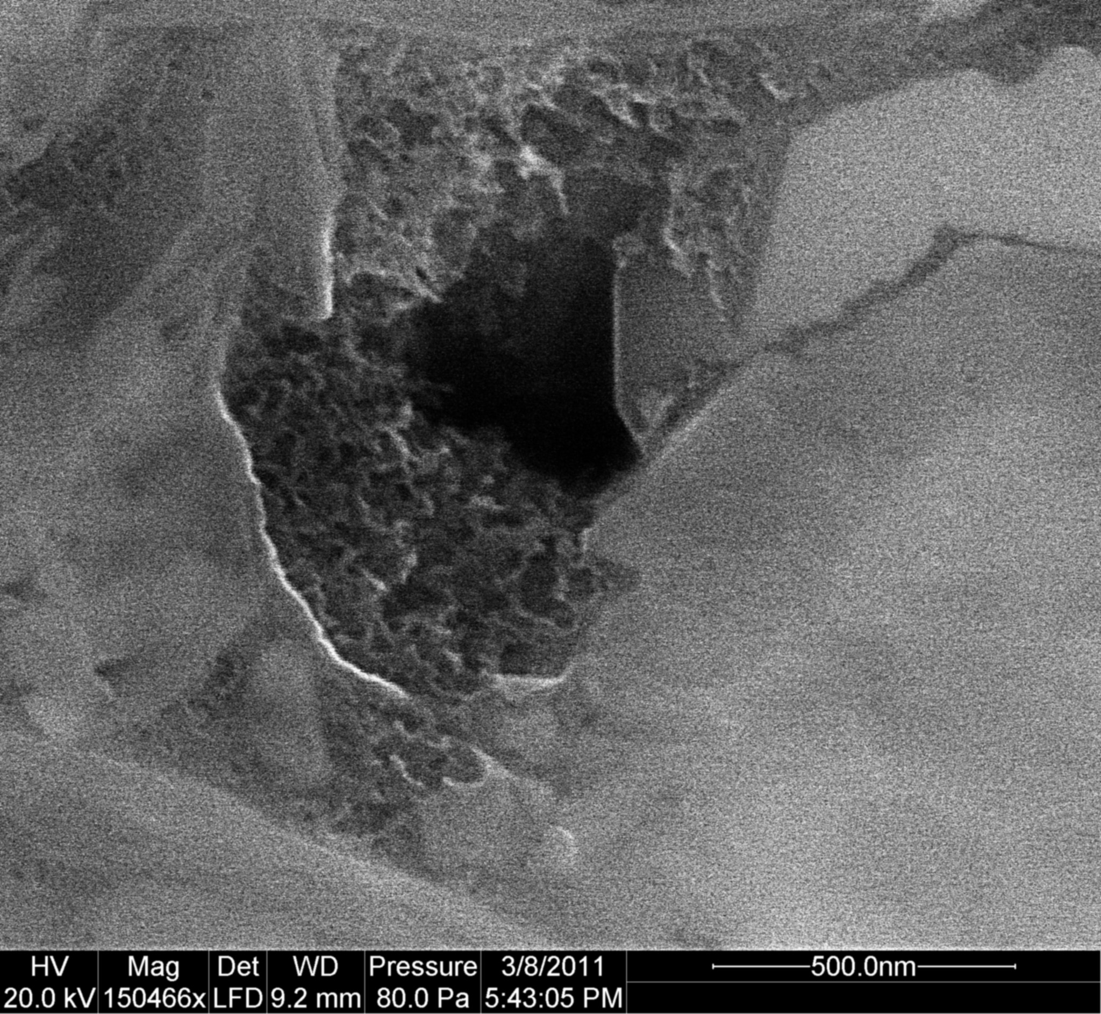
Porosity
In the 200 plus thin sections described, no visible porosity carbonates or shales
The pore system is likely to be almost entirely small organic pores
This is different than the Bakken and Eagle Ford which have important matrix component

Slide 3
Porosity
The lack of matrix porosity other than organic porosity may make the Utica a much better gas reservoir than liquids reservoir
The pores and pore throats may be too small in some cases for larger molecule sizes of some liquid hydrocarbons

Slide 4
Carbonate and TOC content
For the five cores, TOC was analyzed in detail at one per foot through the reservoir interval and every 2-5 feet through the other intervals
Carbonate content was done for all wells except the Harstine Trust

Slide 5
TOC in Cuttings vs Core
Dan Jarvie popularized the idea that for some reason cuttings almost always had lower TOC values than core
The reason for this is probably not that cuttings don’t preserve TOC as well as core
It is almost certainly due to sampling over an interval rather than at specific beds

Slide 6
Depth | TOC | Average
3696.5 | 3.181
3697.5 | 2.3901
3698.5 | 3.0485
3699.5 | 2.4431
3700.5 | 2.8827 | 2.87254
3701.5 | 2.9072
3702.5 | 1.8557
3703.5 | 3.1257
3704.5 | 3.6507
Depth | TOC | Average
3707.5 | 2.953
3708.5 | 4.4016
3709.5 | 2.9672
3710.5 | 3.388 | 3.59885
3711.5 | 3.8896
3712.5 | 3.0145
3713.5 | 4.4109
3714.5 | 4.1224
TOC values from the Eichelberger core taken one per foot
Average is average of ten foot interval
Depth | TOC | Average
3716.5 | 2.8785
3717.5 | 4.0645
3718.5 | 0.8374
3719.5 | 4.5148
3720.5 | 3.8564 | 3.45262
3721.5 | 4.3411
3722.5 | 4.5162
3723.5 | 4.2708
3724.5 | 1.189
Depth | TOC | Average
3726.5 | 4.7598
3727.5 | 4.3131
3728.5 | 1.0381
3729.5 | 2.2621
3730.5 | 1.6587 | 2.6489
3731.5 | 4.3192
3732.5 | 3.2716
3736.5 | 1.1817
3738.5 | 0.6812
If cuttings are saved every ten feet, it may be a mix of that ten foot interval or a single depth within that ten foot interval – note that if it is an average it can still be significantly less than the highest value and that any single value could be significantly lower than the highest value in that interval

Slide 7
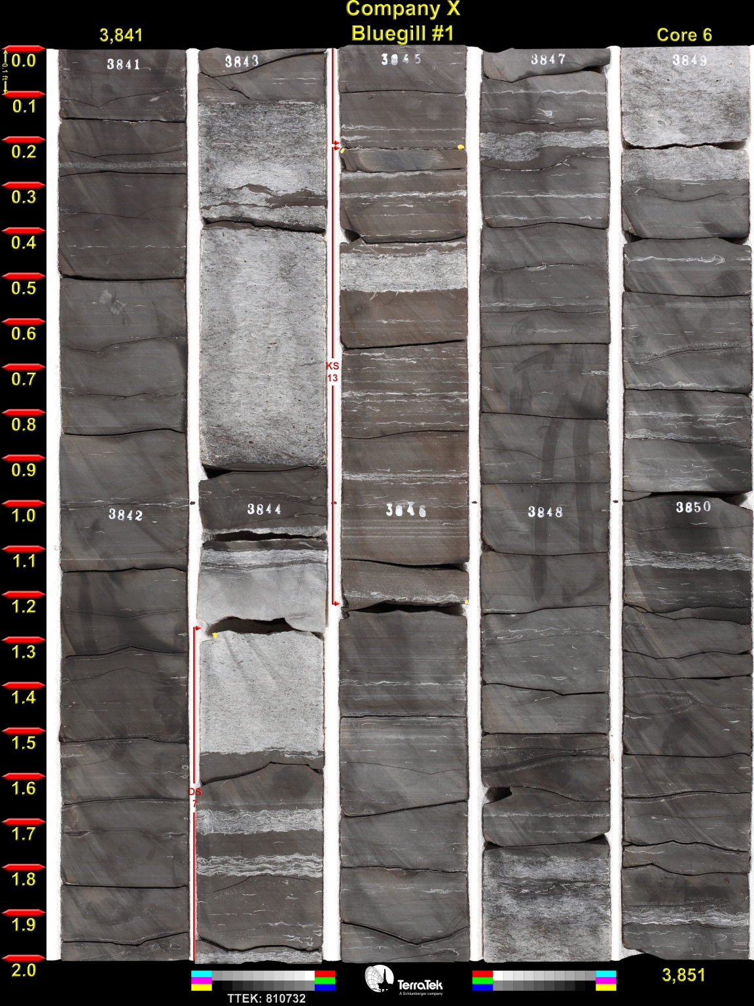
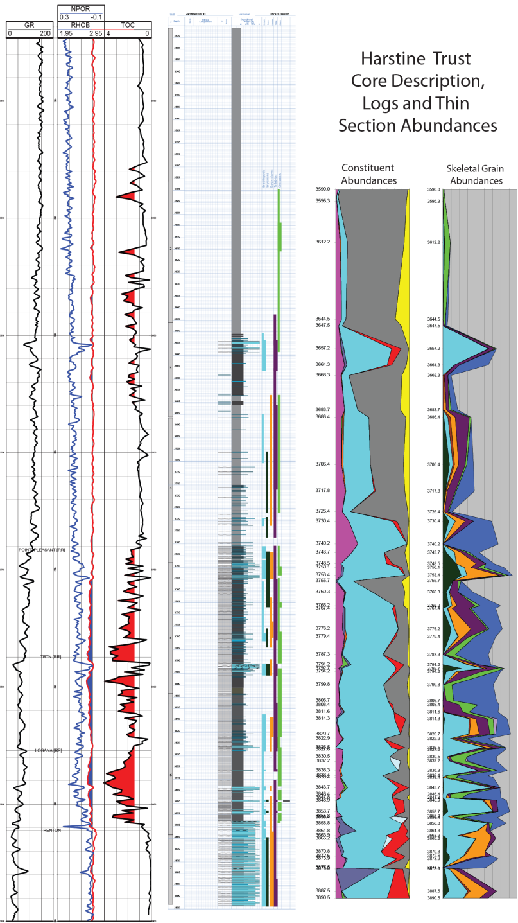
3.1
4.1
3.3
2.6
2.0
0.2
3.4
3.6
3.6
3.3
1.6
3.2
1.2
Samples are from the depths above the values

Slide 8
Put all samples together to make these plots
Blue is all data including original TOC data and the new data
Green line is all data with a 13-point running average that shows large scale trends clearly
Basal lobe is thinner, but has higher TOC (and likely has higher porosity as well)
L. Utica
L. Utica
Point Pleasant (PK)
Point Pleasant (PK)
Lexington (PK)
Lexington (PK)
Trenton (PK)
Trenton (PK)

Slide 9
Carbonate Content
Carbonate content is calculated by crushing and weighing a sample, acidizing it, drying it, weighing it again and then calculating how much sample was lost in acidization
It is a cheap way of getting the carbonate number (way cheaper than XRD)
It should include calcite and dolomite

Slide 10
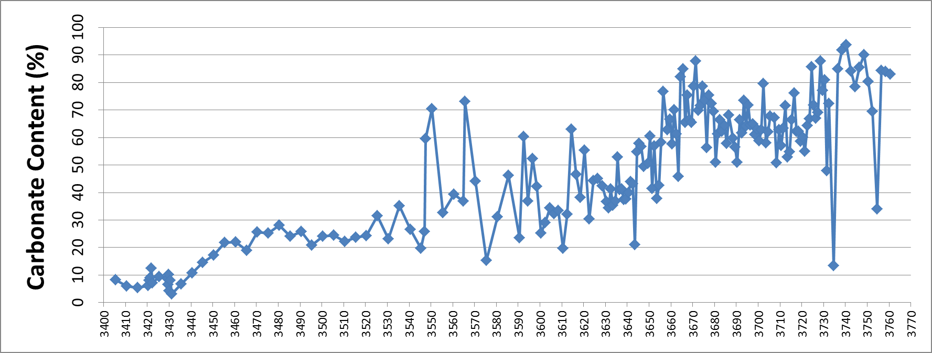
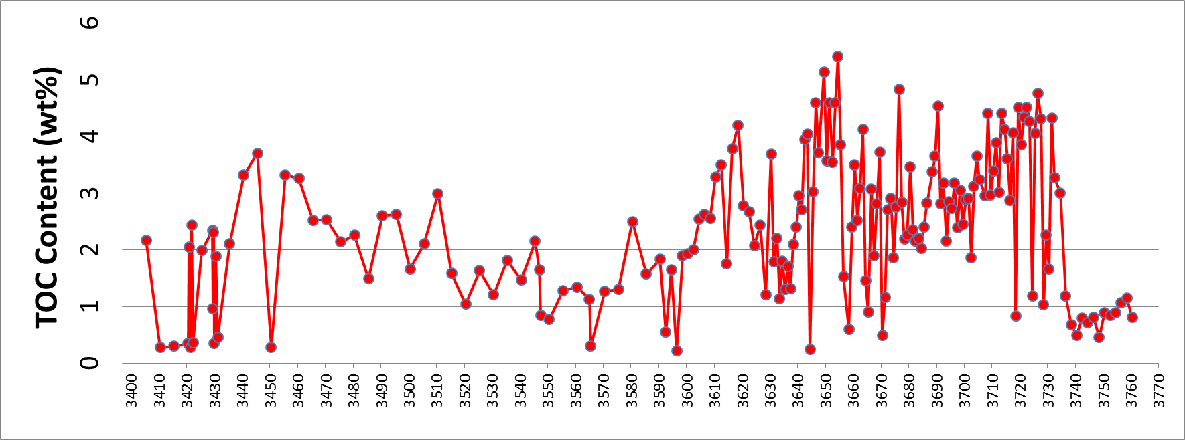
Eichelberger
Carbonate and TOC logs – Carbonate mainly increases from the top down –the best potential reservoir intervals may be the intervals with the highest carbonate percentage and the highest and thickest TOC-rich zones – the Logana has the best of both followed by the basal Point Pleasant
Upper Utica
Middle Utica
Lower Utica
Point Pleasant
Lexington
Logana
Trenton

Slide 11
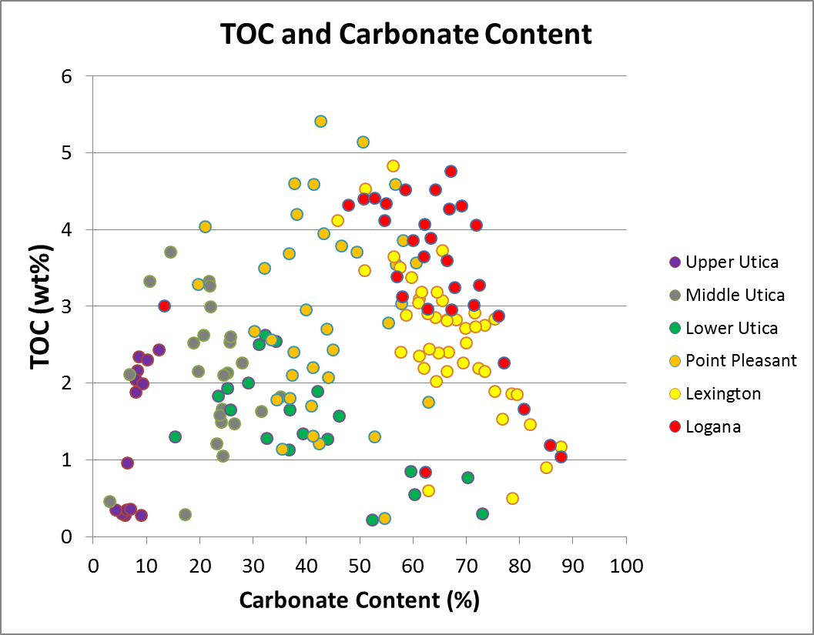
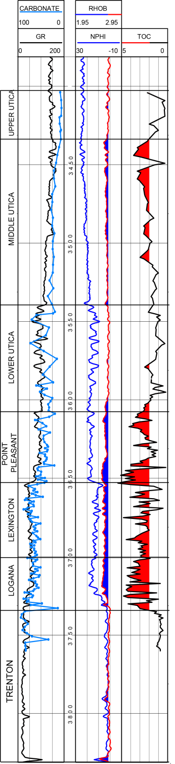
Eichelberger
High TOC is essential as organic porosity seems to be the only significant pore type- High carbonate content should probably increase brittleness - Based on these criteria the Logana looks the best followed by parts of the Lexington and Point Pleasant

Slide 12
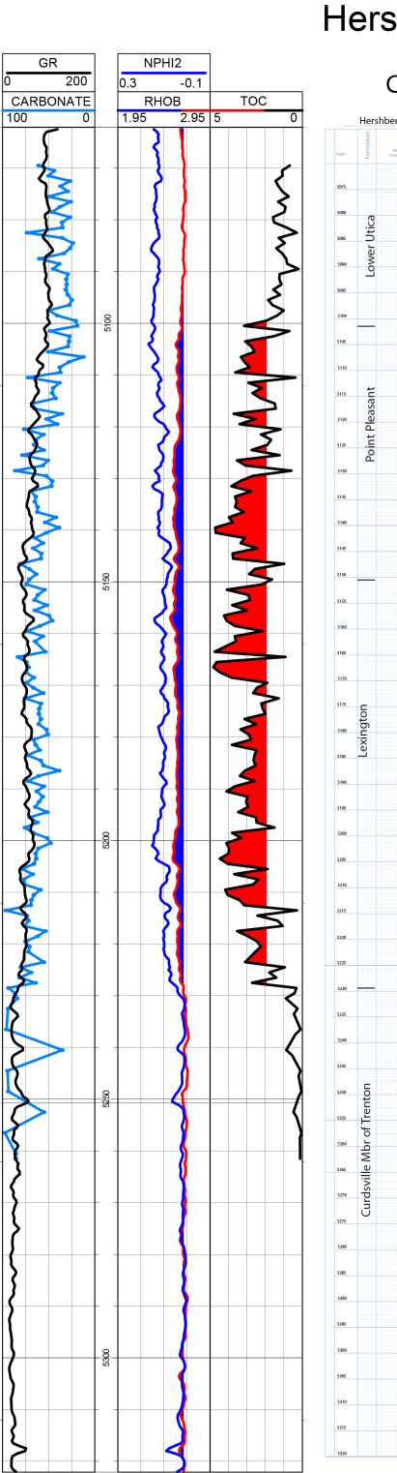
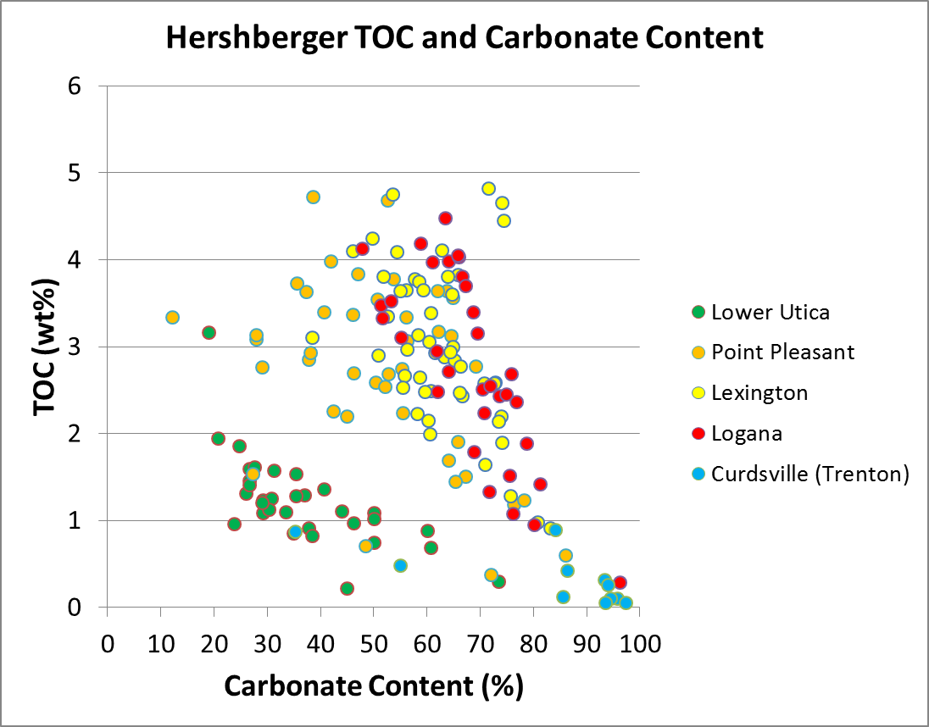
This well has high carbonate and TOC in the Point Pleasant, Lexington and Logana Members – Most of the other wells were not as good in the Point Pleasant

Slide 13
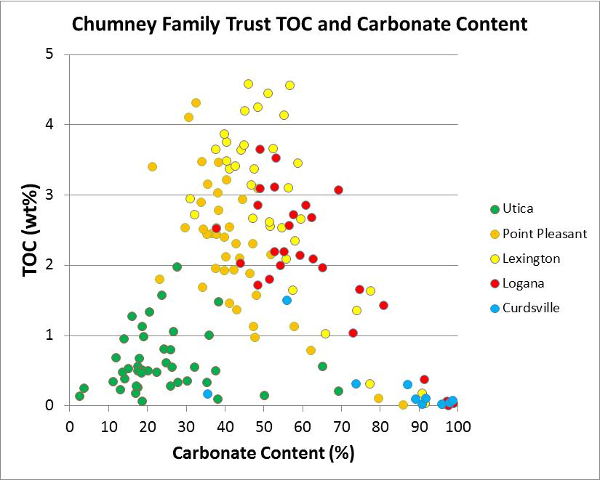
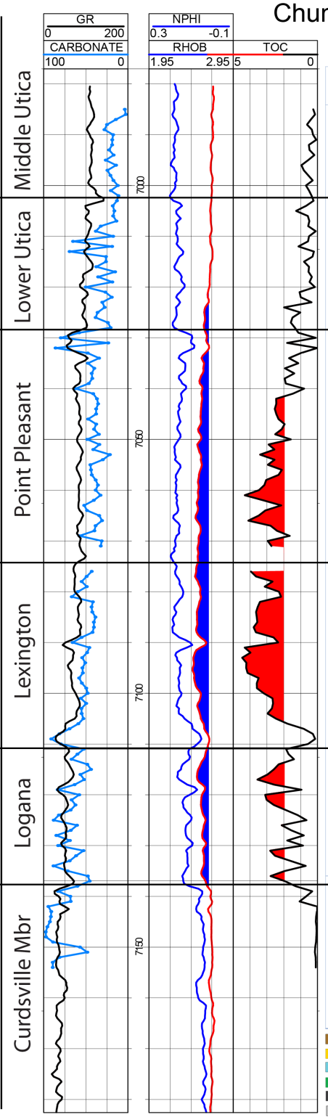
Highest combination of TOC and carbonate in Lexington and Logana – less carbonate in Point Pleasant – this core is more clay-rich than the others examined

Slide 14
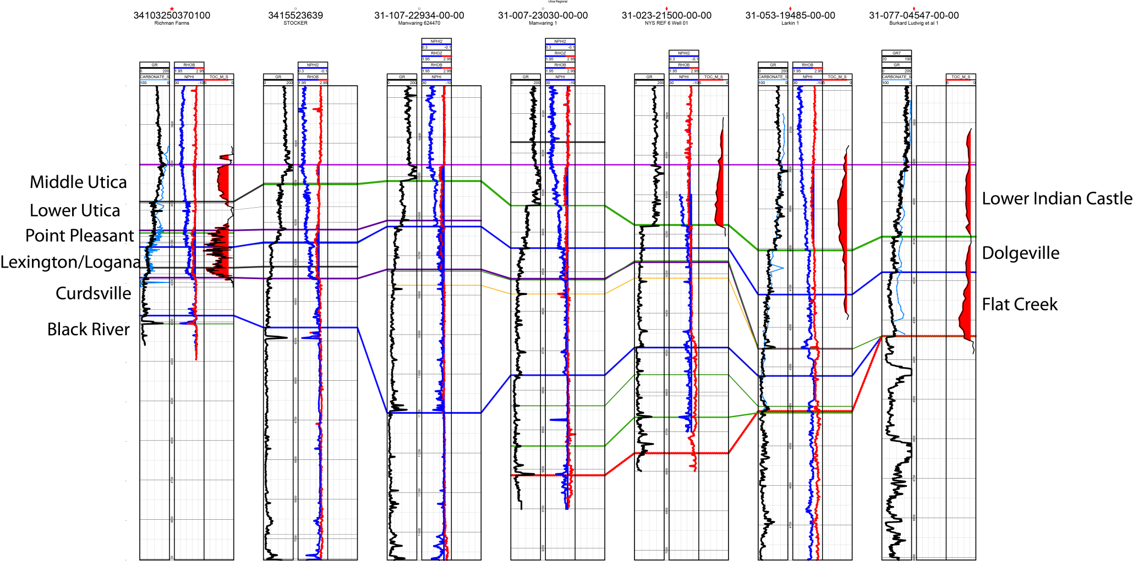

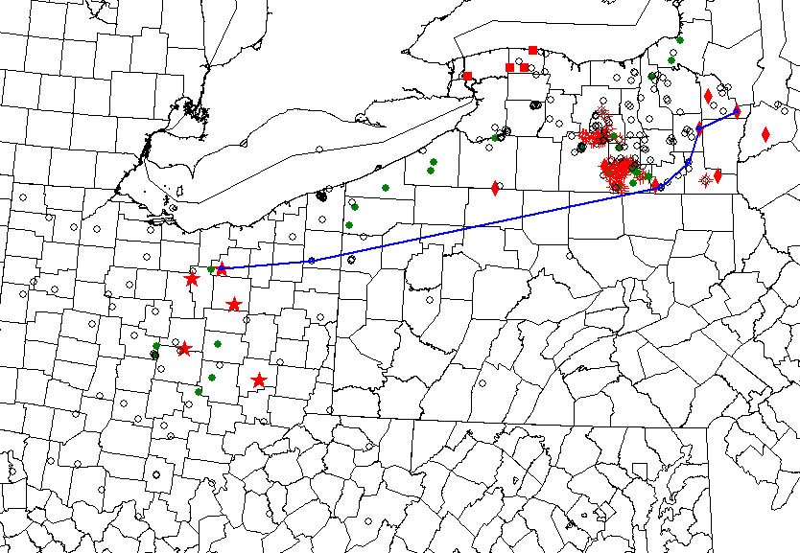
Ohio to New York Cross Section – confirmed by 13C
Disconformity surface at top of organic-rich Utica is datum - Called the Honey Hill Disconformity in NY (Brett and Baird, 2002)
Organic-rich section is same age – Point Pleasant/Lexington/Logana =Dolgeville and Flat Creek Shales

Slide 15
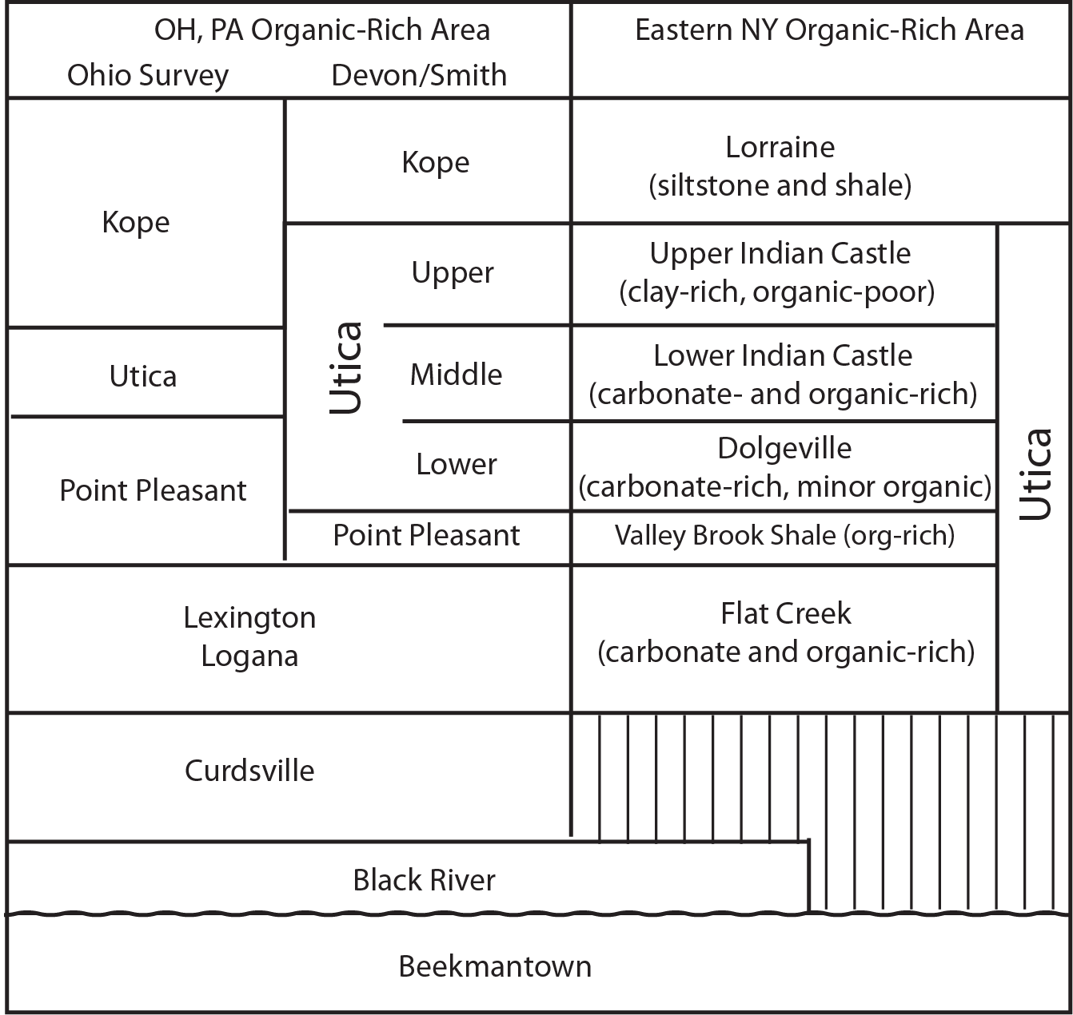
Nomenclature correlation chart for Ohio and New York – sorry for the confusion, will try to clear this up for final report

Slide 16
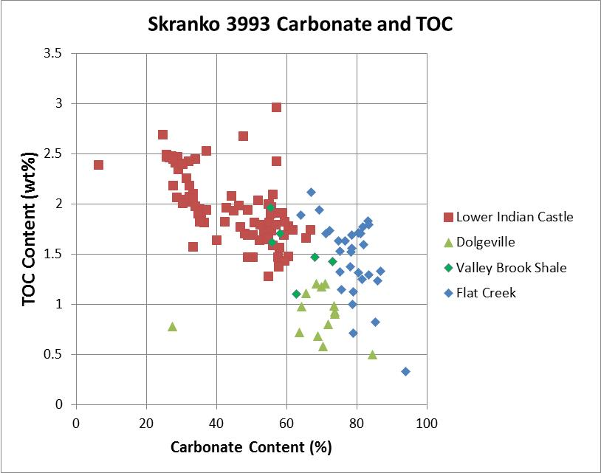
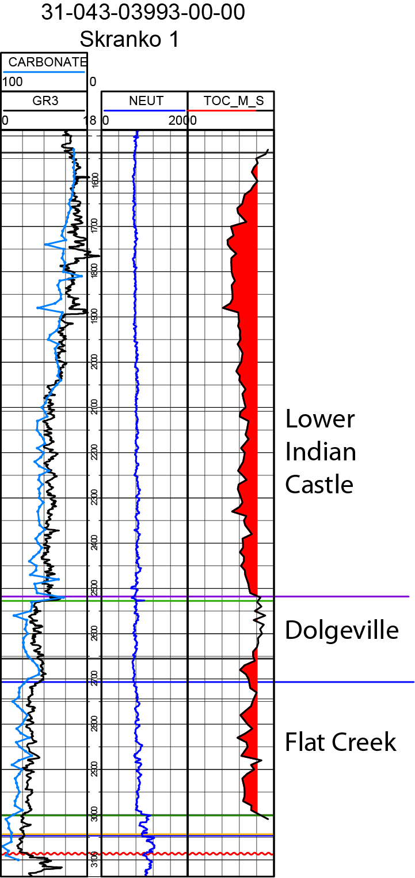
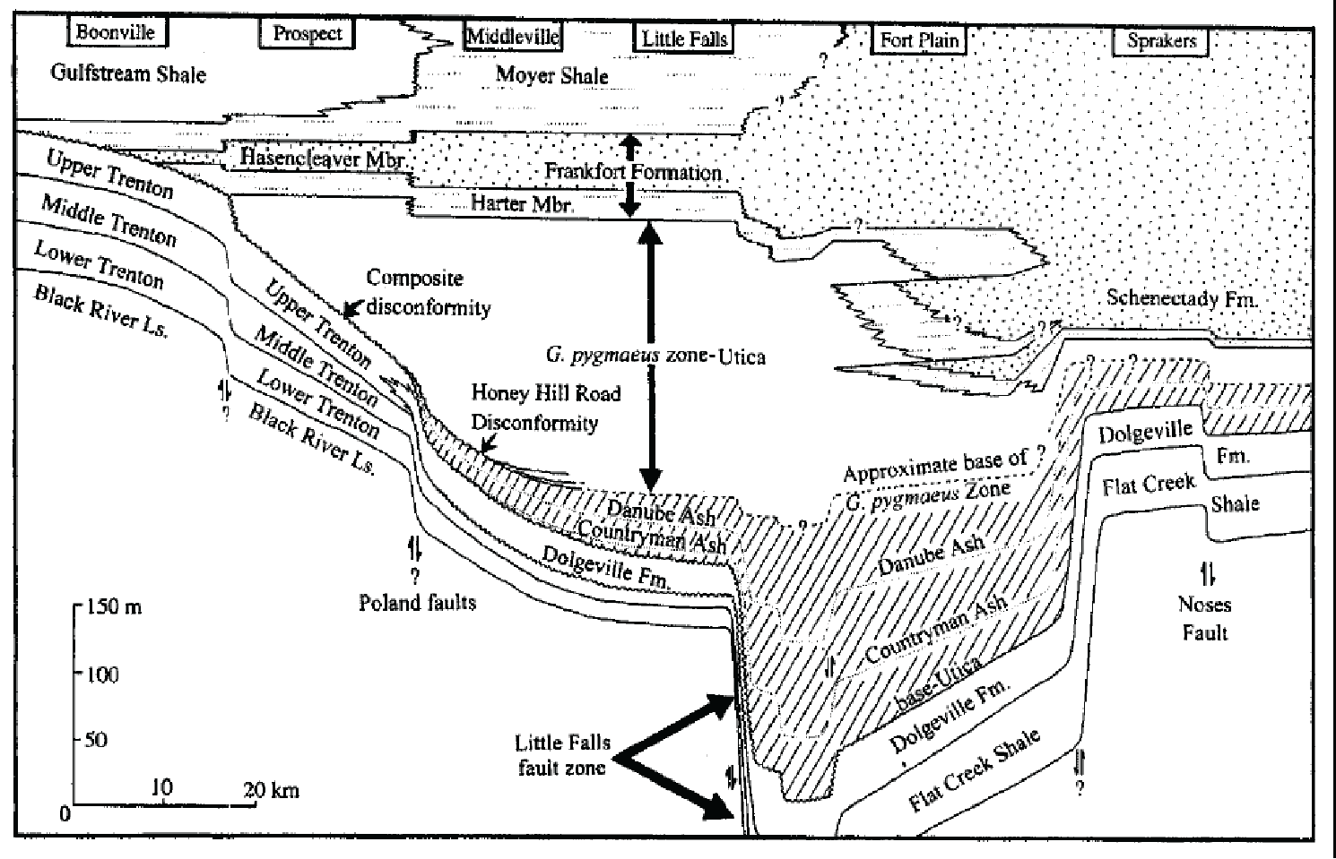
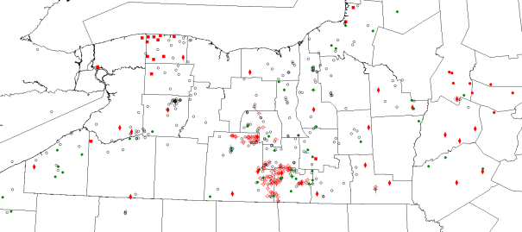
Carbonate vs TOC shows higher TOC and higher clay in Lower Indian Castle (equivalent to Utica in OH)
Higher carbonate and lower TOC in Dolgeville and Flat Creek (Point Pleasant/Lexington/Logana)
Over 1300 feet of >1% TOC in graben fill

Slide 17
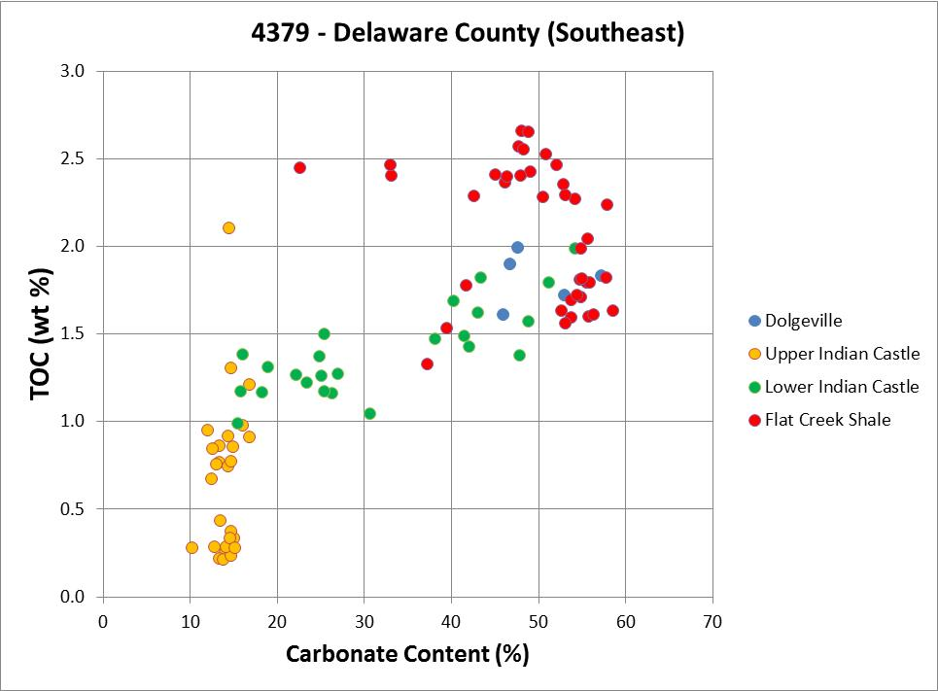
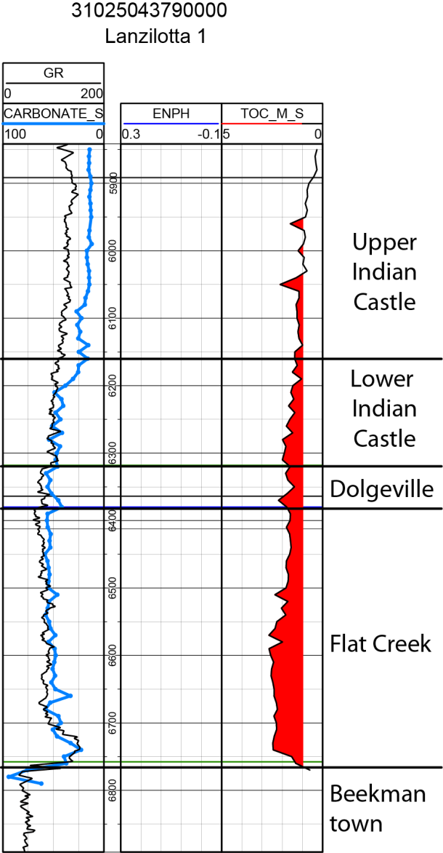
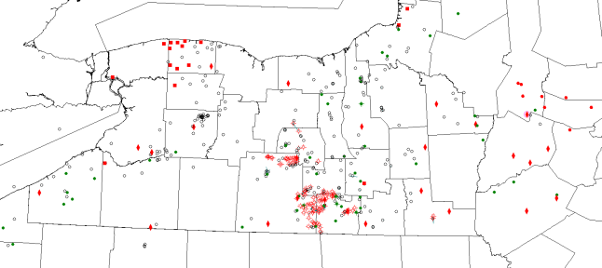
This well is farther to southeast and has better developed Flat Creek (Lexington Logana), a relatively high TOC Dolgeville section ( Point Pleasant equivalent) and relatively organic-poor Lower Indian Castle (Utica equivalent)

Slide 18
Summary
The interval that has highest TOC and carbonate may be the best for targeting horizontals due to higher fraccability
Cross plotting TOC and carbonate is a helpful way to learn which intervals have these qualities
Cross plotting GR and Density may give the same relationships
There are about 50 wells with carbonate and TOC data on the ftp site

Slide 19
Shameless Plug
Smith Stratigraphic LLC
Core and cuttings description
Thin Section Petrography
Geochemistry and Diagenesis
Local and Regional Stratigraphic Correlation
Integrated Reservoir Characterization
Field Trips to Utica and Marcellus in NYS
smithstrat@gmail.com, 518-369-6431

